Slide 1
Course: Digital Logic Design
Lecture No.03
BSAI/SE – 2nd
Instructor: Dr. Tahir Ejaz

Slide 2
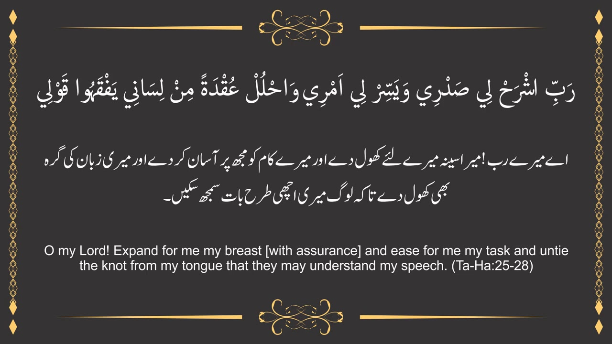

Slide 3
Lecture Contents
Boolean Algebra and Expressions
Laws & Rules of Boolean Algebra
DeMorgan’s Theorems

Slide 4
Boolean Algebra & Expressions

Slide 5
Boolean Algebra
Boolean algebra is the mathematics of digital systems.
A basic knowledge of Boolean algebra is indispensable to the study and analysis of logic.
In the last lecture, Boolean operations and expressions in terms of their relationship to NOT, AND, OR, NAND, NOR XOR and XNOR gates were introduced.

Slide 6
Boolean Algebra
Variable, complement, and literal are terms used in Boolean algebra.
A variable is a symbol (usually an italic uppercase letter) used to represent a logical quantity.
Any single variable can have a 1 or a 0 value.

Slide 7
Boolean Algebra
The complement is the inverse of a variable and is indicated by a bar over the variable.
A literal is a variable or the complement of a variable.

Slide 8
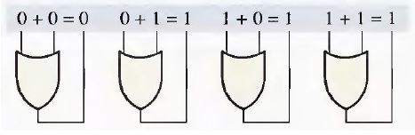
Boolean Algebra (Addition)
Boolean Addition:
  Boolean addition is equivalent to the OR operation.
  In Boolean algebra, a sum term is a sum of literals.
  In logic circuits, a sum term is produced by an OR operation with no AND operations involved.
  Some examples of sum terms are
  A + B, A + C, A + B + C, and A + B + C + D.

Slide 9
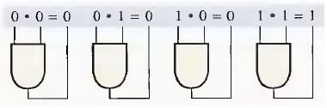
Boolean Algebra (Multiplication)
Boolean Multiplication:
  Boolean multiplication is equivalent to the AND operation.
  In Boolean algebra, a product term is the product of literals.
  A product term is equal to 1 only if each of the literals in the term is 1.
  Some examples of product terms are AB, AC, ABC, and ABCD.

Slide 10
Laws & Rules Of Boolean Algebra

Slide 11
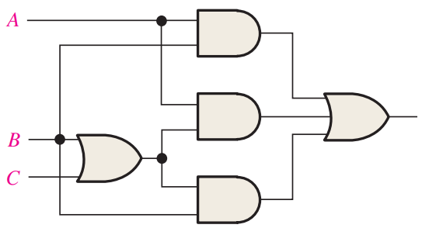
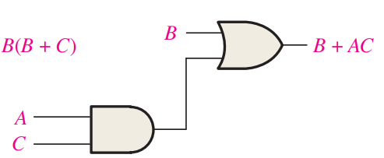

Why Boolean Algebra

Slide 12
Laws & Rules of Boolean Algebra
The most important rules of Boolean Algebra are:
  Commutative Laws of addition and multiplication
  Associative Laws of addition and multiplication.
  Distributive law.
  Twelve basic rules of Boolean algebra

Slide 13

Laws & Rules of Boolean Algebra
Commutative Law of Addition:
  A + B = B + A
  This law states that the order in which the variables are ORed makes no difference.
  Figure below shows the commutative law as applied to the OR gate and shows that it doesn't matter to which input each variable is applied.

Slide 14
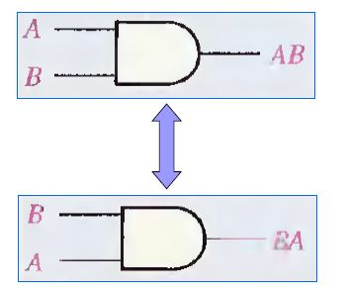
Laws & Rules of Boolean Algebra
Commutative Law of Multiplication:
  AB = BA
  This law states that the order in which the variables are ANDed makes no difference.

Slide 15
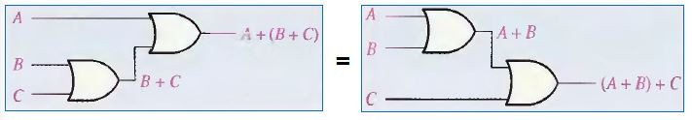
Laws & Rules of Boolean Algebra
Associative Laws
  The associative law of addition is written as follows for three variables:
  A + (B + C) = (A + B) + C
  This law states that when ORing more than two variables, the result is the same regardless of the grouping of the variables.

Slide 16
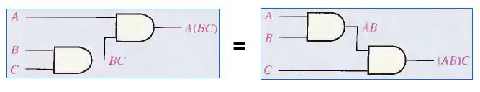
Laws & Rules of Boolean Algebra
Associative Laws
  The associative law of multiplication is written as follows for three variables:
  A(BC) = (AB)C
  This law states that it makes no difference in what order the variables are grouped when ANDing more than two variables.

Slide 17
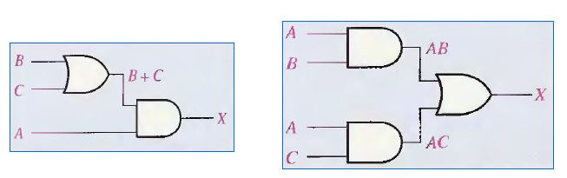
Laws & Rules of Boolean Algebra
Distributive Law
  The distributive law is written for three variables as follows:
  A(B + C) = AB + AC

Slide 18
Laws & Rules of Boolean Algebra
Twelve (12) basic rules of BA
  Table on next slide enlist 12 basic rules that are useful in manipulating and simplifying Boolean expressions.
  Rules 1 through 9 will be viewed in terms of their application to logic gates.
  Rules 10 through 12 will be derived in terms of the simpler rules and the laws previously discussed.

Slide 19
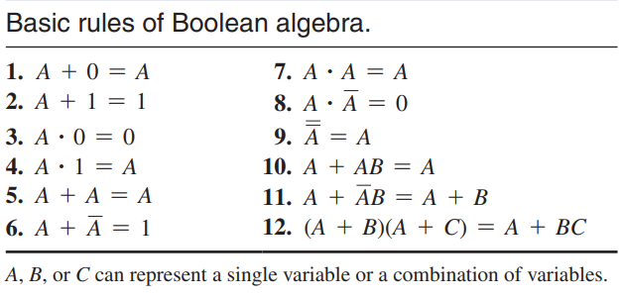
Laws & Rules of Boolean Algebra
Twelve (12) basic rules of BA

Slide 20
Laws & Rules of Boolean Algebra
Proof: Rule 10 (Absorption)
    A + A.B = A
    A + A.B = A . 1 + A.B
    = A ( 1 + B)
    = A . 1
    = A

Slide 21
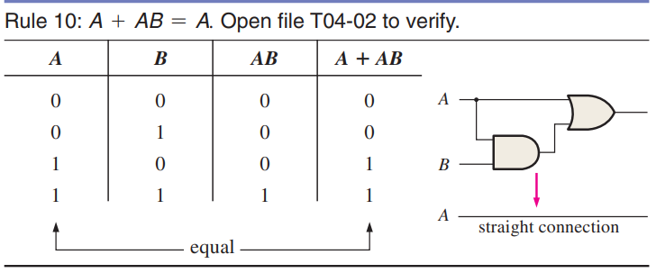
Laws & Rules of Boolean Algebra
Proof: Rule 10 (Absorption)
  The proof is shown in Table below, which shows the truth table and the resulting logic circuit simplification.

Slide 22
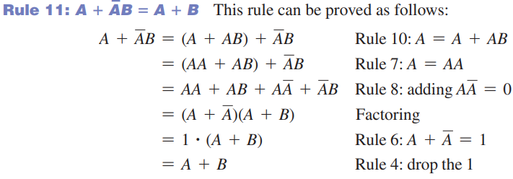
Laws & Rules of Boolean Algebra
Proof: Rule 11 (A + A’B = A + B)
    This rule can be proved as follows:

Slide 23
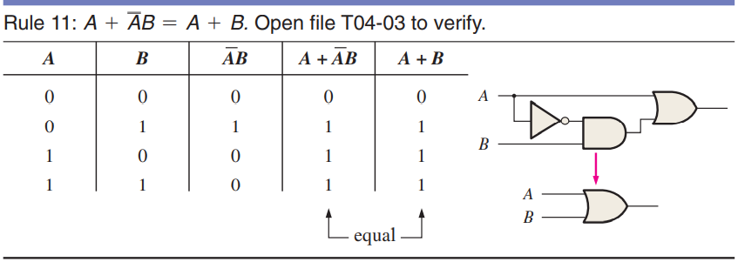
Laws & Rules of Boolean Algebra
Proof: Rule 11 (A + A’B = A + B)
  The proof is shown in truth table and the resulting logic circuit simplification.

Slide 24
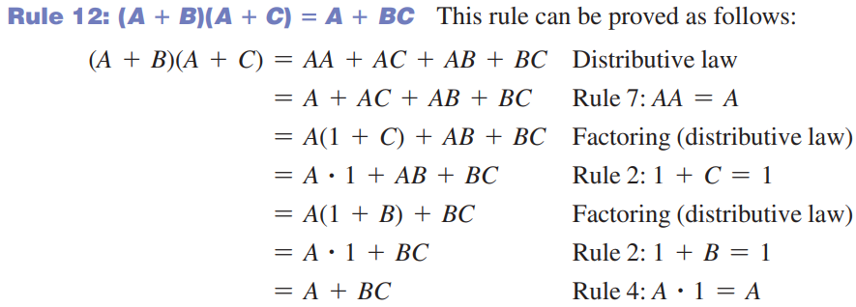
Laws & Rules of Boolean Algebra
Proof: Rule 12 ((A + B)(A + C) = A + BC)

Slide 25
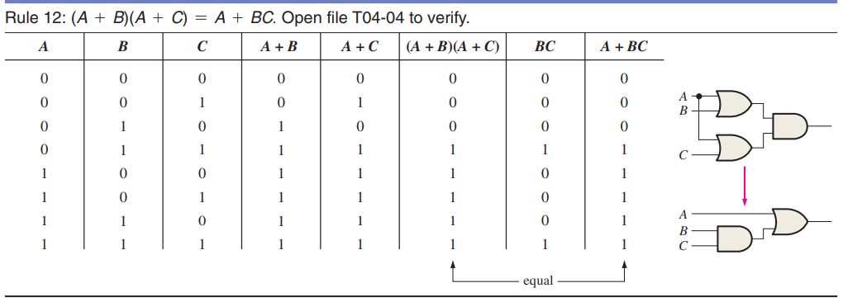
Laws & Rules of Boolean Algebra

Slide 26
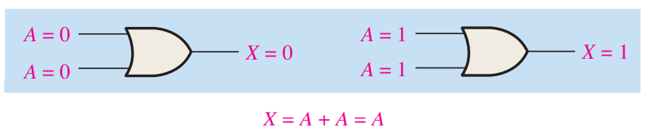
Laws & Rules of Boolean Algebra
Proof: Rule 5 (A + A = A)
    A + A = A
    A + A = (A + A).1
    = (A + A) . ( A + A′)
    = A + A.A′
    = A + 0
    = A

Slide 27
Laws & Rules of Boolean Algebra
Proof: Rule 7 (A.A = A)
    A . A = A
    A . A = (A . A) + 0
    = (A . A) + ( A . A′)
    = A (A + A′)
    = A . 1
    = A
Proof: Rule 2 (A + 1 = 1)
    A + 1 = 1

Slide 28
DeMorgan’s Theorems

Slide 29
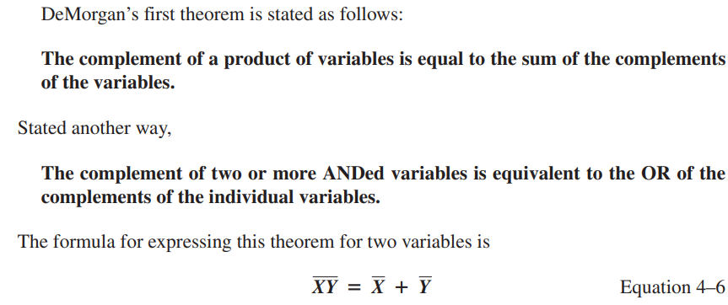
DeMorgan’s Theorems (1st)

Slide 30

DeMorgan’s Theorems (2nd)

Slide 31
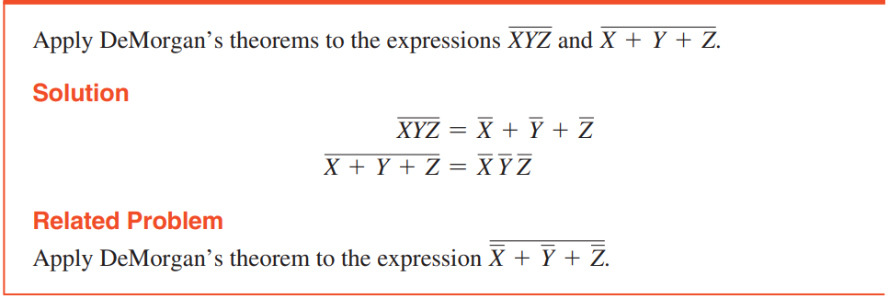
DeMorgan’s Theorems (Examples)

Slide 32
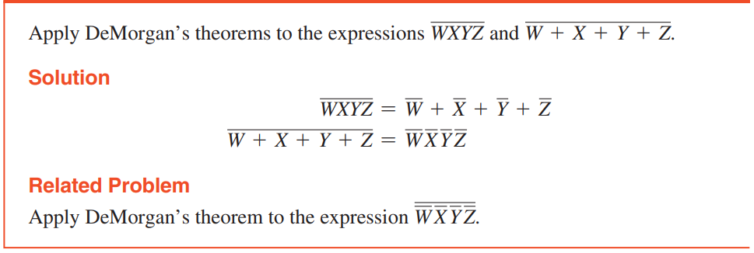
DeMorgan’s Theorems (Examples)

Slide 33
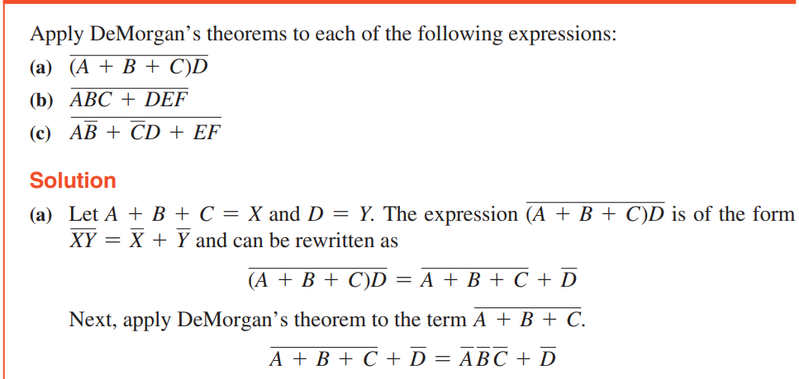
DeMorgan’s Theorems (Examples)

Slide 34
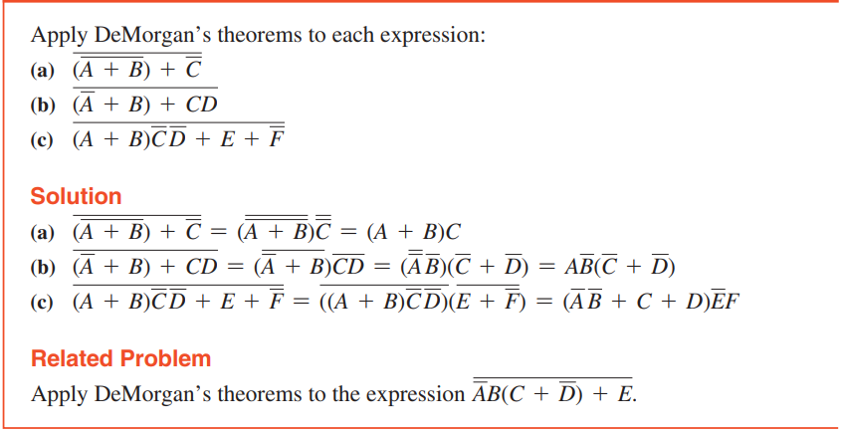
DeMorgan’s Theorems (Examples)

Slide 35
Lecture Summary
Boolean Algebra and Expressions
  Examples
  Problems
Laws & Rules of Boolean Algebra
  Examples
  Problems
DeMorgan’s Theorems
  Proof, Examples & Problems

Slide 36
Useful Videos
https://www.youtube.com/watch?v=2U71nZYb990
https://www.youtube.com/watch?v=nhYH3Gtn3RE
https://www.youtube.com/watch?v=MxNQpXyieWo

Slide 37
Thank You !

